Slide 1
Harmful Brain Activity Classification
Kunxiao Gao, Yuzhe Guo

Slide 2
Introduction
Background: Physicians use EEG with critically ill patients to detect seizures and other types of brain activity that can cause brain damage.
Current issue: labor-intensive process, time-consuming, expensive
Significance: Improve automated EEG analysis to higher efficiency with acceptable accuracy.
Goal: Implement Resnet and Efficientnet with Multiple Instance Learning to do the harmful brain activity classification based on EEG and Spectrograms data, and compare and analyze if our implemented model could have good performance on automated EEG analysis.

Slide 3
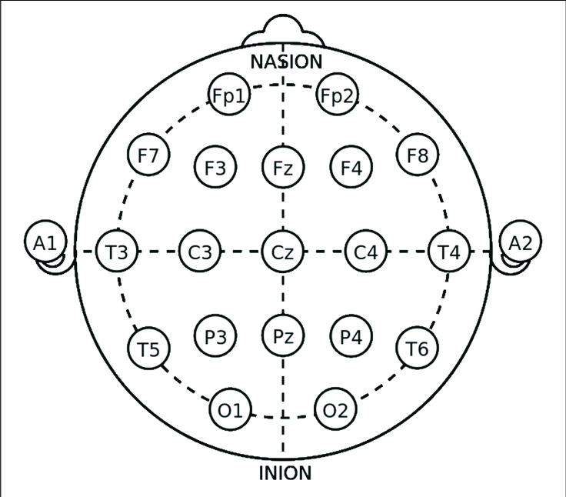
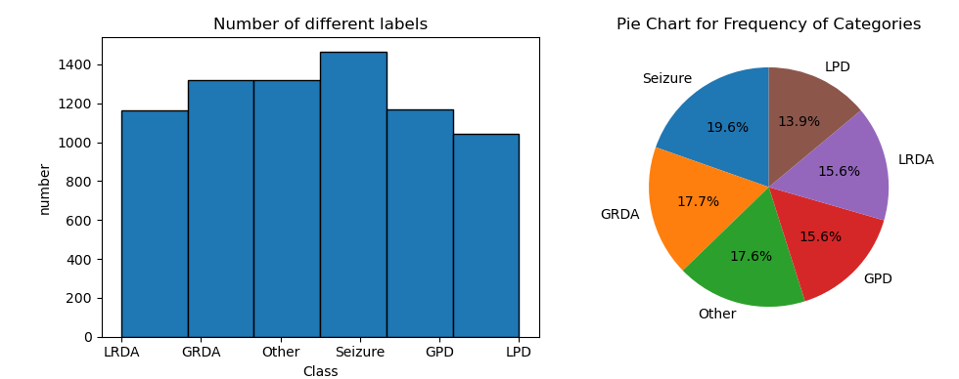
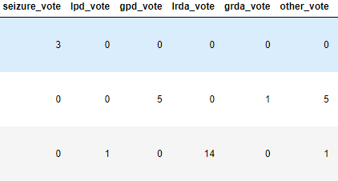
EEG Data & Label & Vote
Raw EEG data:
19 column, each column is for an electrode that records data from different locations, + one column, which is EKG, electrocardiogram lead that records data from the heart → total 20 column.
Sample frequency = 200 Hz, each sample duration = 50 sec → total 10_000 samples per second.
Hence, for one data, the shape is 20 x 10_000
Each number in data represent voltage measurement
Class:
6 different class: Seizure, LPD, GRDA, LRDA, GPD, Other
The dataset is relatively balanced.
Vote:
The count of annotator votes for a given brain activity class.
We use this to calculate loss.
The number of vote does not sum to a fixed number –→ solution: normalized to 1

Slide 4
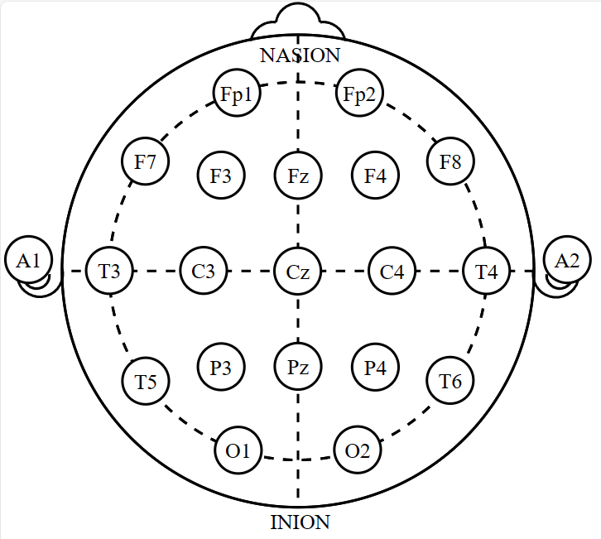
Data Preparation - spectrogram
Embedding EEG covering 10 a minute window centered at the same time and labeled the central 10 seconds.
Do not use whole egg electrodes but divided them into 4 larger panels
For electrodes in each panels, take Fourier Transform and Avg to generate one spectrogram in each panel.
LP(Left Parasagittal)
RL(Right Lateral)
LL(Left Lateral)
RP (Right Parasagittal)
https://www.ncbi.nlm.nih.gov/pmc/articles/PMC7461156/

Slide 5
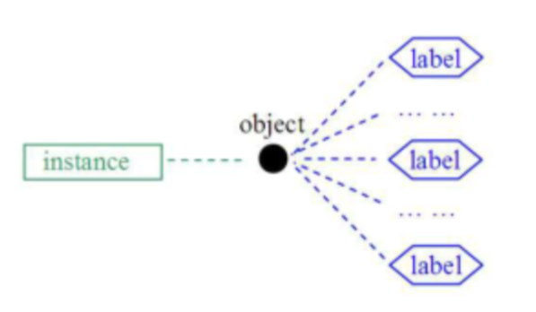
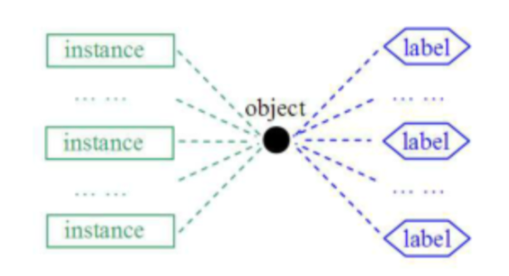
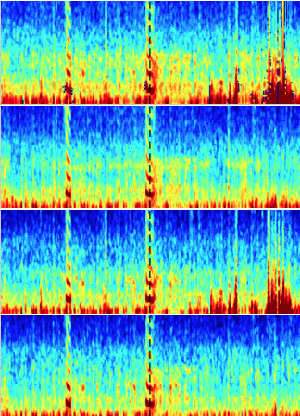
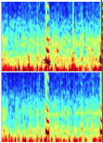
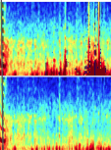
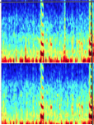
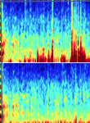
MIL(Multiple Instance Learning)

Slide 6
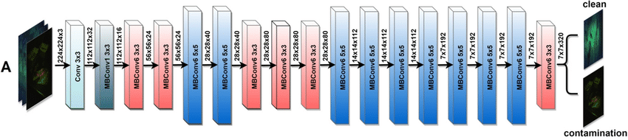
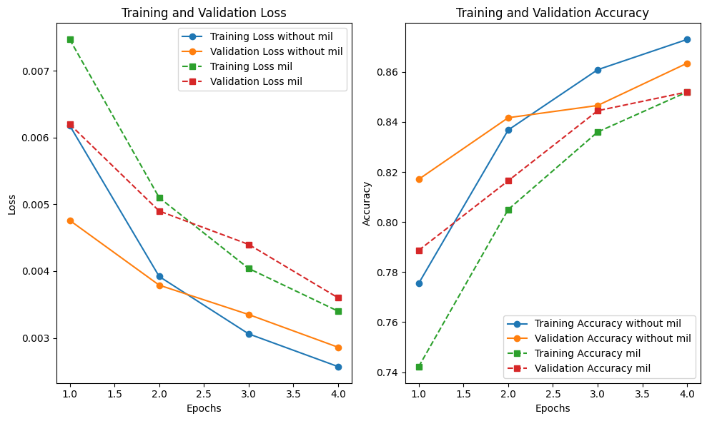
EfficientNet with and without MIL on Spectrogram
Model | Efficientnet without MIL | Efficientnet MIL
Test Acc | 0.8604 | 0.8454
Test Loss | 0.00303 | 0.00359

Slide 7
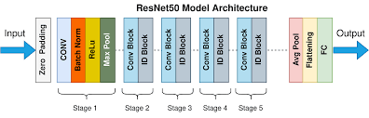
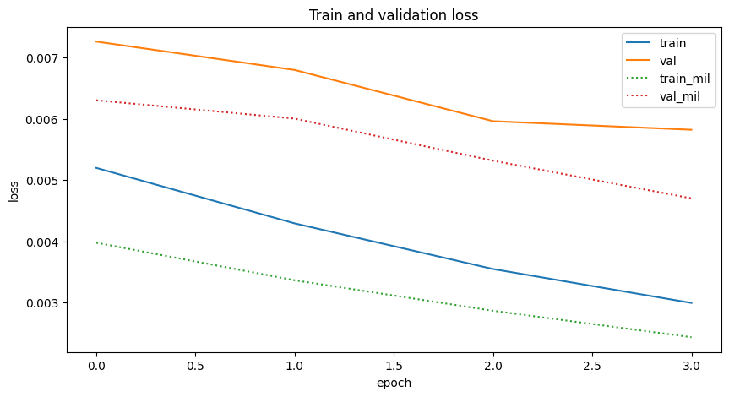
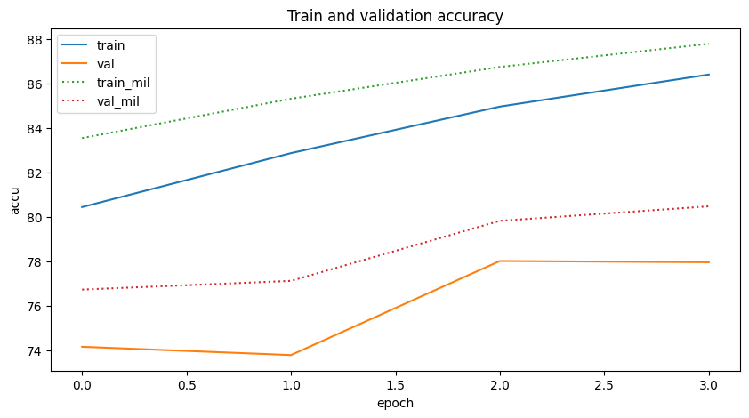
Resnet with and without MIL (Spe)
Model | Resnet without MIL | Resnet MIL
Test Acc | 0.7689 | 0.7921
Test Loss | 0.0065 | 0.0055

Slide 8
Comparison on the Test accuracy and Loss
Model | Spec & Efficient Net with MIL | Spec & Efficient Net without MIL | Spec & ResNet-50 with MIL | Spec & ResNet-50 without MIL
Test Accuracy | 0.8454 | 0.8604 | 0.7921 | 0.7689
Test Loss | 0.00359 | 0.00303 | 0.0055 | 0.0065
Comparison on the Testing loss for different MIL strategies
stride\kernel | 150 * 200 | 200 * 300 | 100 * 200 | 100 * 150
150 | 0.0055 | \ | \ | \
50 | 0.0041 | 0.0044 | 0.0039 | 0.0049
100 | \ | 0.0051 | 0.0049 | \

Slide 9
Discussion
EfficientNet's design ensures it can adapt more effectively to this multi-scale information.
Feature unrecognizable in eeg spectrogram data which cause MIL do not increase overall performance for efficient net.
Kernel and stride will influence the overall performance on resnet.
Future Work
Use more different MIL strategies(different sub-image size, different selecting area)
Apply attention mechanism
Jin Jing, Zhen Lin, Chaoqi Yang, Ashley Chow, Sohier Dane, Jimeng Sun, M. Brandon Westover. (2024). HMS - Harmful Brain Activity Classification . Kaggle. https://kaggle.com/competitions/hms-harmful-brain-activity-classification

